Slide 1
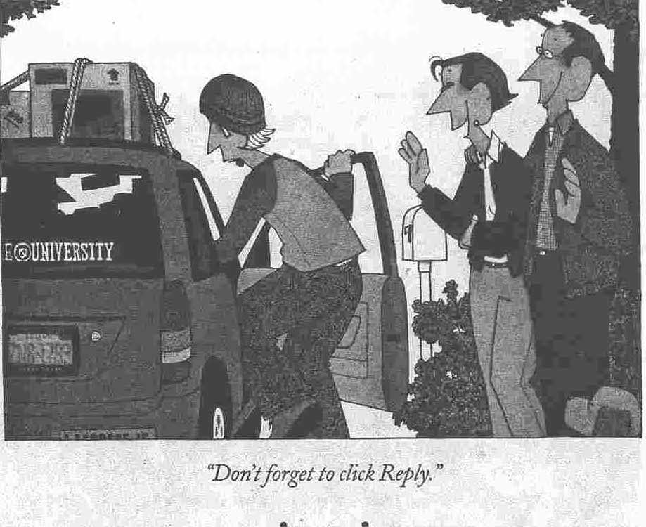
Introduction to Computer Networking
Dr. Shelly Heller
sheller@gwu.edu

Slide 2
Part I: Introduction
Chapter goal:
get context, overview, “feel” of networking
more depth, detail later in course
approach:
  descriptive
  use Internet as example
Overview:
what’s the Internet
what’s a protocol?
network edge
network core
access net, physical media
performance: loss, delay
protocol layers, service models
backbones, NAPs, ISPs
history
ATM network

Slide 3
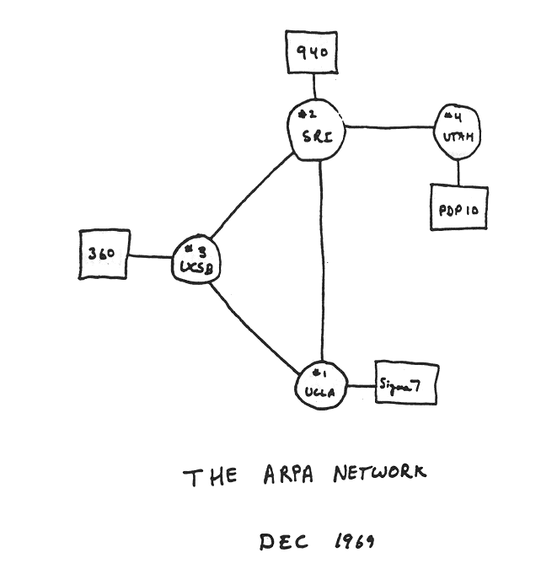
Internet history
1961-1972: Early packet-switching principles
1961: Kleinrock - queueing theory shows effectiveness of packet-switching
1964: Baran - packet-switching in military nets
1967: ARPAnet conceived by Advanced Research Projects Agency
1969: first ARPAnet node operational
1972:
  ARPAnet public demo
  NCP (Network Control Protocol) first host-host protocol
  first e-mail program
  ARPAnet has 15 nodes

Slide 4
Internet history
1972-1980: Internetworking, new and proprietary nets
1970: ALOHAnet satellite network in Hawaii
1974: Cerf and Kahn - architecture for interconnecting networks
1976: Ethernet at Xerox PARC
late70’s: proprietary architectures: DECnet, SNA, XNA
late 70’s: switching fixed length packets (ATM precursor)
1979: ARPAnet has 200 nodes
Cerf and Kahn’s internetworking principles:
  minimalism, autonomy - no internal changes required to interconnect networks
  best effort service model
  stateless routers
  decentralized control
define today’s Internet architecture

Slide 5
Internet history
1980-1990: new protocols, a proliferation of networks
1983: deployment of TCP/IP
1982: smtp e-mail protocol defined
1983: DNS defined for name-to-IP-address translation
1985: ftp protocol defined
1988: TCP congestion control
new national networks: CSnet, BITnet, NSFnet, Minitel
100,000 hosts connected to confederation of networks
Check out the Morris Worm
Story (attached to todays session

Slide 6
Internet history
1990, 2000’s: commercialization, the Web, new apps
early 1990’s: ARPAnet decommissioned
1991: NSF lifts restrictions on commercial use of NSFnet (decommissioned, 1995)
early 1990s: Web
  hypertext [Bush 1945, Nelson 1960’s]
  HTML, HTTP: Berners-Lee
  1994: Mosaic, later Netscape
  late 1990’s: commercialization of the Web
late 1990’s – 2000’s:
more killer apps: instant messaging, P2P file sharing
network security to forefront
est. 50 million host, 100 million+ users
backbone links running at Gbps

Slide 7
Internet history
2005-present
~5B devices attached to Internet (2016)
  smartphones and tablets
aggressive deployment of broadband access
increasing ubiquity of high-speed wireless access
emergence of online social networks:
  Facebook: ~ 1.7 billion users
service providers (Google, Microsoft) create their own networks
  bypass Internet, providing “instantaneous” access to search, video content, email, etc.
e-commerce, universities, enterprises running their services in “cloud” (e.g., Amazon EC2)
The “MAP”

Slide 8
What’s the Internet: “nuts and bolts” view
router
workstation
millions of connected computing devices: hosts, end-systems
  pc’s workstations, servers
  PDA’s phones, toasters
  running network apps
communication links
  fiber, copper, radio, satellite
routers: forward packets (chunks) of data thru network
server
mobile
local ISP
regional ISP
company
network

Slide 9





With modern ‘nuts and bolts’
Smart Lock:
Check door status away from home
Smart Vents
Smart Fridge tool
I want one!
Why?

Slide 10
What’s the Internet: “nuts and bolts” view
protocols: control sending, receiving of msgs
  e.g., TCP, IP, HTTP, FTP, PPP
Internet: “network of networks”
  loosely hierarchical
  public Internet versus private intranet
Internet standards
  RFC: Request for comments
  IETF: Internet Engineering Task Force
router
workstation
server
mobile
local ISP
regional ISP
company
network
http://www.faqs.org/rfcs/

Slide 11
What’s the Internet: a service view
communication infrastructure enables distributed applications:
  WWW, email, games, e-commerce, database., voting,
  more?
communication services provided:
  connectionless
  connection-oriented
cyberspace
Interesting historical look at cyberspace until 2004
Notes:
Additional history
http://www.mappingcyberspace.com/gallery/

Slide 12
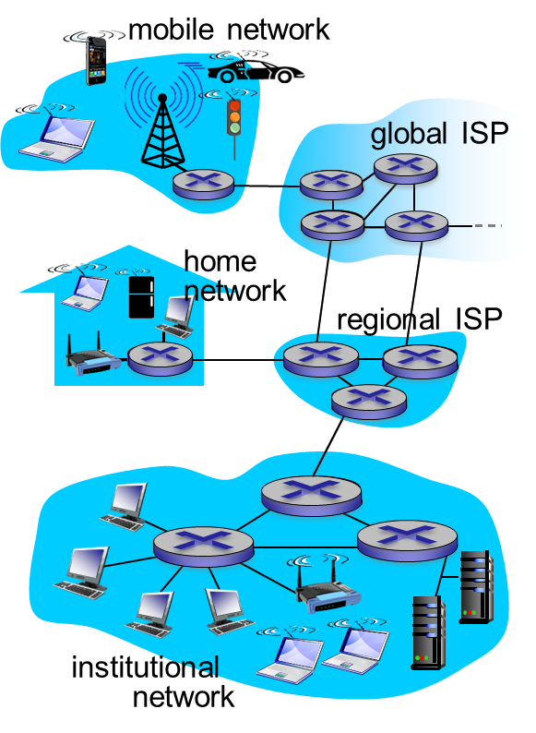
A closer look at network structure:
network edge: applications and hosts
network core:
  routers
  network of networks
access networks, physical media: communication links

Slide 13
The network edge:
end systems (hosts):
  run application programs
  e.g., WWW, email
  at “edge of network”
client/server model
  client host requests, receives service from server
  e.g., WWW client (browser)/ server; email client/server
peer-peer model:
  host interaction symmetric
  e.g.: teleconferencing

Slide 14
Network edge: connection-oriented service
Goal: data transfer between end sys.
handshaking: setup (prepare for) data transfer ahead of time
  End systems ‘know’ of connection - set up “state” in two communicating hosts
  Routers, etc do not ‘know’ about the connection
TCP - Transmission Control Protocol
  Internet’s connection-oriented service
TCP service [RFC 793]
reliable, in-order byte-stream data transfer
  loss: acknowledgements and retransmissions
flow control:
  sender won’t overwhelm receiver
congestion control:
  senders “slow down sending rate” when network congested

Slide 15
Network edge: connectionless service
Goal: data transfer between end systems
  same as before!
UDP - User Datagram Protocol [RFC 768]: Internet’s connectionless service
  unreliable data transfer
  no flow control
  no congestion control
App’s using TCP:
HTTP (WWW), FTP (file transfer), Telnet (remote login), SMTP (email)
App’s using UDP:
streaming media, teleconferencing, Internet telephony

Slide 16















Access networks and physical media
Q: How to connect end systems to edge router?
residential access nets
institutional access networks (school, company)
mobile access networks
keep in mind:
bandwidth (bits per second) of access network?
shared or dedicated?

Slide 17

Access network: digital subscriber line (DSL)
Did we ever really do this?
central office
telephone
network
DSL
modem
splitter
DSLAM
ISP
voice, data transmitted
at different frequencies over
dedicated line to central office
DSL access
multiplexer
  use existing telephone line to central office DSLAM
    data over DSL phone line goes to Internet
    voice over DSL phone line goes to telephone net
  < 2.5 Mbps upstream transmission rate (typically < 1 Mbps)
  < 24 Mbps downstream transmission rate (typically < 10 Mbps)

Slide 18



Access network: cable network
cable headend
…
cable
modem
splitter
C
O
N
T
R
O
L
V
I
D
E
O
V
I
D
E
O
V
I
D
E
O
V
I
D
E
O
V
I
D
E
O
V
I
D
E
O
D
A
T
A
D
A
T
A
1
2
3
4
5
6
7
8
9
Channels
frequency division multiplexing: different channels transmitted
in different frequency bands

Slide 19
Access network: cable network
cable headend
…
cable
modem
splitter
CMTS
cable modem
termination system
data, TV transmitted at different
frequencies over shared cable
distribution network
ISP
HFC: hybrid fiber coax
  asymmetric: up to 30Mbps downstream transmission rate, 2 Mbps upstream transmission rate
network of cable, fiber attaches homes to ISP router
  homes share access network to cable headend
  unlike DSL, which has dedicated access to central office

Slide 20







Access network: home network
wireless
devices
to/from headend or central office
often combined
in single box
cable or DSL modem
wireless access
point (54 Mbps)
router, firewall, NAT
wired Ethernet (1 Gbps)

Slide 21









Enterprise access networks (Ethernet)
institutional link to
ISP (Internet)
institutional router
Ethernet
switch
institutional mail,
web servers
typically used in companies, universities, etc.
  10 Mbps, 100Mbps, 1Gbps, 10Gbps transmission rates
  today, end systems typically connect into Ethernet switch

Slide 22









Wireless access networks
shared wireless access network connects end system to router
  via base station aka “access point”
wide-area wireless access
  provided by telco (cellular) operator, 10’s km
  between 1 and 10 Mbps
  3G, 4G: LTE
wireless LANs:
  within building (100 ft.)
  802.11b/g/n (WiFi): 11, 54, 450 Mbps transmission rate
to Internet
to Internet
Good question – Wifi or Ethernet!

Slide 23
Internet structure: network of networks
End systems connect to Internet via access ISPs (Internet Service Providers)
  residential, company and university ISPs
Access ISPs in turn must be interconnected.
  so that any two hosts can send packets to each other
Resulting network of networks is very complex
  evolution was driven by economics and national policies
Let’s take a stepwise approach to describe current Internet structure

Slide 24
Internet structure: network of networks
Question: given millions of access ISPs, how to connect them together?
…
…
access
net
access
net
access
net
access
net
access
net
access
net
access
net
…
…
access
net
access
net
access
net
access
net
access
net
access
net
…
access
net
access
net
…
access
net

Slide 25
Internet structure: network of networks
Option: connect each access ISP to every other access ISP?
…
…
access
net
access
net
access
net
access
net
access
net
…
…
access
net
access
net
…
connecting each access ISP to each other directly doesn’t scale: O(N²) connections.
…
…
access
net
access
net
…
access
net
access
net
access
net
…
access
net
…
access
net
access
net
…
access
net

Slide 26
Internet structure: network of networks
Option: connect each access ISP to one global transit ISP?
Customer and provider ISPs have economic agreement.
…
…
access
net
access
net
access
net
access
net
access
net
access
net
access
net
…
…
global
ISP
access
net
access
net
access
net
access
net
access
net
access
net
…
access
net
access
net
…
access
net

Slide 27
Internet structure: network of networks
But if one global ISP is viable business, there will be competitors ….
…
…
access
net
access
net
access
net
access
net
access
net
access
net
ISP A
access
net
…
…
access
net
ISP B
access
net
ISP C
access
net
access
net
access
net
access
net
…
access
net
access
net
…
access
net

Slide 28
Internet structure: network of networks
But if one global ISP is viable business, there will be competitors …. which must be interconnected
Internet exchange point
…
…
access
net
access
net
access
net
access
net
access
net
IXP
access
net
access
net
ISP A
…
…
access
net
IXP
ISP B
access
net
ISP C
access
net
access
net
peering link
access
net
access
net
…
access
net
access
net
…
access
net

Slide 29
Internet structure: network of networks
… and regional networks may arise to connect access nets to ISPs
…
…
access
net
access
net
access
net
access
net
access
net
IXP
access
net
access
net
ISP A
…
…
access
net
IXP
ISP B
access
net
ISP C
access
net
access
net
access
net
regional net
access
net
…
access
net
access
net
…
access
net

Slide 30
Internet structure: network of networks
… and content provider networks (e.g., Google, Microsoft, Akamai) may run their own network, to bring services, content close to end users
…
…
access
net
access
net
access
net
access
net
access
net
IXP
access
net
access
net
ISP A
…
…
Content provider network
access
net
IXP
ISP B
access
net
ISP C
access
net
access
net
access
net
regional net
access
net
…
access
net
access
net
…
access
net

Slide 31
Internet structure: network of networks
Tier 1 ISP
Tier 1 ISP
Google
IXP
IXP
IXP
Regional ISP
Regional ISP
access
ISP
access
ISP
access
ISP
access
ISP
access
ISP
access
ISP
access
ISP
access
ISP
at center: small # of well-connected large networks
  “tier-1” commercial ISPs (e.g., Level 3, Sprint, AT&T, NTT), national & international coverage
  content provider network (e.g., Google): private network that connects it data centers to Internet, often bypassing tier-1, regional ISPs

Slide 32
Tier 1 ISPs
What are they?: A Tier 1 ISP is an ISP that has access to the entire Internet Region solely via its free and reciprocal peering agreements.
Who are they? In the U.S. the Tier 1 ISPs include:
AT&T
Verizon
Sprint (Softbank Broadband)
Century Link (Qwest)
Level 3 (with Global Crossing now)
NTT/Verio
Cogent (maybe?)
In China the Tier 1 ISPs are
China Telecom
China Unicom (China Netcom)
The litmus test is, "Does this ISP pay anyone (or barter)
to reach any destination in the Internet Region?"
If the answer is "No" then it is a "Tier 1 ISP"
and if the answer is "Yes" then it is a "Tier 2 ISP."

Slide 33
Tier-1 ISP: e.g., Sprint
POP: point-of-presence
to/from backbone
peering
…
…
…
…
…
to/from customers

Slide 34

Host: sends packets of data
host sending function:
takes application message
breaks into smaller chunks, known as packets, of length L bits
transmits packet into access network at transmission rate R
  link transmission rate, aka link capacity, aka link bandwidth
two packets,
L bits each
2
1
R: link transmission rate
host
packet
transmission
delay
time needed to
transmit L-bit
packet into link
L (bits)
R (bits/sec)
=

Slide 35
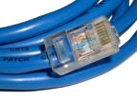
Physical media
bit: propagates between
transmitter/receiver pairs
physical link: what lies between transmitter & receiver
guided media:
  signals propagate in solid media: copper, fiber, coax
unguided media:
  signals propagate freely, e.g., radio
twisted pair (TP)
two insulated copper wires
  Category 5: 100 Mbps, 1 Gbps Ethernet
  Category 6: 10Gbps

Slide 36


Physical media: coax, fiber
coaxial cable:
two concentric copper conductors
bidirectional
broadband:
  multiple channels on cable
  HFC
fiber optic cable:
glass fiber carrying light pulses, each pulse a bit
high-speed operation:
  high-speed point-to-point transmission (e.g., 10’s-100’s Gbps transmission rate)
low error rate:
  repeaters spaced far apart
  immune to electromagnetic noise

Slide 37
Physical media: radio
signal carried in electromagnetic spectrum
no physical “wire”
bidirectional
propagation environment effects:
  reflection
  obstruction by objects
  interference
radio link types:
terrestrial microwave
  e.g. up to 45 Mbps channels
LAN (e.g., WiFi)
  54 Mbps
wide-area (e.g., cellular)
  4G cellular: ~ 10 Mbps
satellite
  Kbps to 45Mbps channel (or multiple smaller channels)
  270 msec end-end delay
  geosynchronous versus low altitude

Slide 38
The Network Core
mesh of interconnected routers
the fundamental question: how is data transferred through net?
  circuit switching: dedicated circuit per call: telephone net
  packet-switching: data sent thru net in discrete “chunks”

Slide 39
Network Core: Circuit Switching
End-end resources reserved for “call”
link bandwidth, switch capacity
dedicated resources: no sharing
circuit-like (guaranteed) performance
call setup required

Slide 40
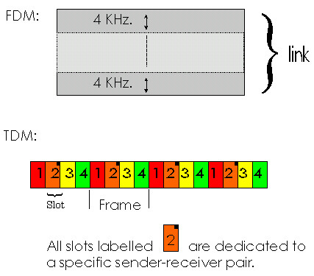
Network Core: Circuit Switching
network resources (e.g., bandwidth) divided into “pieces”
pieces allocated to calls
resource piece idle if not used by owning call (no sharing)
dividing link bandwidth into “pieces”
  frequency division
  time division

Slide 41
Network Core: Packet Switching
10 Mbs
Ethernet
A
C
statistical multiplexing
1.5 Mbs
B
queue of packets
waiting for output
link
45 Mbs
D
E
Packet-switching versus circuit switching

Slide 42



Packet-switching: store-and-forward
L bits
per packet
source
3
2
1
R bps
R bps
destination
takes L/R seconds to transmit (push out) L-bit packet into link at R bps
store and forward: entire packet must arrive at router before it can be transmitted on next link
one-hop numerical example:
L = 7.5 Mbits
R = 1.5 Mbps
one-hop transmission delay = 5 sec
end-end delay = 2L/R (assuming zero propagation delay)
more on delay shortly …

Slide 43
Packet Switching: queueing delay, loss
R = 100 Mb/s
C
A
D
R = 1.5 Mb/s
B
E
queue of packets
waiting for output link
queuing and loss:
if arrival rate (in bits) to link exceeds transmission rate of link for a period of time:
  packets will queue, wait to be transmitted on link
  packets can be dropped (lost) if memory (buffer) fills up

Slide 44
Two key network-core functions
routing: determines source-destination route taken by packets
  routing algorithms
forwarding: move packets from router’s input to appropriate router output
routing algorithm
local forwarding table
header value
output link
0100
0101
0111
1001
3
2
2
1
1
3
2
0111
destination address in arriving
packet’s header

Slide 45
Alternative core: circuit switching
end-end resources allocated to, reserved for “call” between source & dest:
in diagram, each link has four circuits.
  call gets 2nd circuit in top link and 1st circuit in right link.
dedicated resources: no sharing
  circuit-like (guaranteed) performance
circuit segment idle if not used by call (no sharing)
commonly used in traditional telephone networks

Slide 46
Circuit switching: FDM versus TDM
Example:
FDM
4 users
frequency
time
TDM
frequency
time
Notes:
Two simple multiple access control techniques.
Each mobile’s share of the bandwidth is divided into portions for the uplink and the downlink. Also, possibly, out of band signaling.
As we will see, used in AMPS, GSM, IS-54/136

Slide 47
Packet switching versus circuit switching
packet switching allows more users to use network!
example:
1 Mb/s link
each user:
  100 kb/s when “active”
  active 10% of time
circuit-switching:
  10 users
packet switching:
  with 35 users, probability > 10 active at same time is less than .0004 *
N
users
…..
1 Mbps link
Q: how did we get value 0.0004?
Q: what happens if > 35 users ?

Slide 48
Packet switching versus circuit switching
is packet switching a “slam dunk winner?”
great for bursty data
  resource sharing
  simpler, no call setup
excessive congestion possible: packet delay and loss
  protocols needed for reliable data transfer, congestion control
Q: How to provide circuit-like behavior?
  bandwidth guarantees needed for audio/video apps
  still an unsolved problem (chapter 7)
Q: human analogies of reserved resources (circuit switching) versus on-demand allocation (packet-switching)?

Slide 49
Network Core: Packet Switching
each end-end data stream divided into packets
user A, B packets share network resources
each packet uses full link bandwidth
resources used as needed,
resource contention:
aggregate resource demand can exceed amount available
congestion: packets queue, wait for link use
store and forward: packets move one hop at a time –wait for entire packet
  transmit over link
  wait turn at next link
Bandwidth division into “pieces”
Dedicated allocation
Resource reservation

Slide 50
Network Core: Message Switching
Message-switching:
store and forward behavior
Source
Packet Switch
Packet Switch
Destination
Message
0
Message
5
Message
10
Message
15
Time (sec)
Consider a message that is 7.5 Mbits long and each link has a transmission rate of 1.5 Mbps. Assuming there is no congestion in the network, how much time is required to move the message from source to destination?

Slide 51
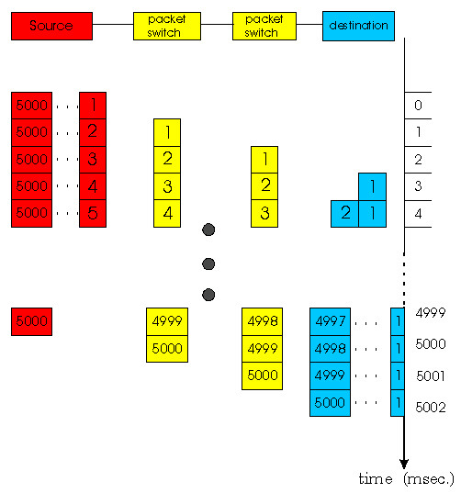
Network Core: Packet Switching
Packet-switching:
store and forward behavior
Consider that same message that is 7.5 Mbits long is split into 5000 packets and each link still has a transmission rate of 1.5 Mbps. Assuming there is no congestion in the network, how much time is required to move the message from source to destination?

Slide 52
Packet switching versus circuit switching
Packet switching allows more users to use network!
1 Mbit link
each user:
  100Kbps when “active”
  active 10% of time
circuit-switching:
  10 users
packet switching:
  with 35 users, probability > 10 active less that .004
N users
1 Mbps link

Slide 53
Packet switching versus circuit switching
Is packet switching a “slam dunk winner?”
Great for bursty data
  resource sharing
  no call setup
Excessive congestion: packet delay and loss
  protocols needed for reliable data transfer, congestion control
Q: How to provide circuit-like behavior?
  bandwidth guarantees needed for audio/video apps
  still an unsolved problem (chapter 6)

Slide 54
Packet-switched networks: routing
Goal: move packets among routers from source to destination
  we’ll study several path selection algorithms (chapter 4)
datagram network:
  destination address determines next hop
  routes may change during session
  analogy: driving, asking directions
virtual circuit network:
  each packet carries tag (virtual circuit ID), tag determines next hop
  fixed path determined at call setup time, remains fixed thru call
  routers maintain per-call state

Slide 55
Access networks and physical media
Q: How to connect end systems to edge router?
residential access nets
institutional access networks (school, company)
mobile access networks
Keep in mind:
bandwidth (bits per second) of access network?
shared or dedicated?

Slide 56
Residential access: point to point access
Dialup via modem
  up to 56Kbps direct access to router (conceptually)
ISDN: integrated services digital network: 128Kbps all-digital connect to router
ADSL: asymmetric digital subscriber line
  up to 1 Mbps home-to-router
  up to 8 Mbps router-to-home
  ADSL deployment:
  http://www.DSLreports.com/distance

Slide 57
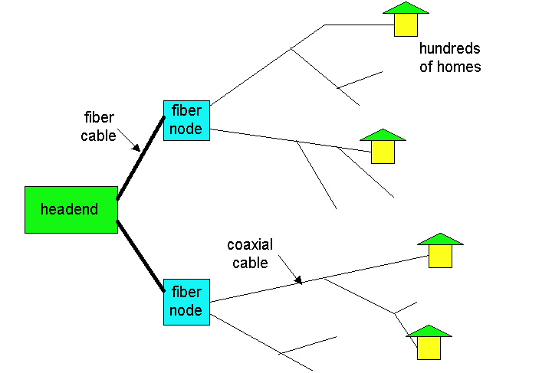
Residential access: cable modems
HFC: hybrid fiber coax
  asymmetric: up to 1Mbps upstream, 10 Mbps downstream
network of cable and fiber attaches homes to ISP router
  shared access to router
  among home
  issues: congestion,
  dimensioning
deployment: available via
cable companies,
e.g., MediaOne, Time-Warner, etc.

Slide 58
Institutional access: local area networks
company/univ local area network (LAN) connects end system to edge router
Ethernet:
  shared or dedicated cable connects end system and router
  10 Mbs, 100Mbps, Gigabit Ethernet (1000 Mbps)
deployment: institutions, home LANs soon
LANs: chapter 5

Slide 59
Wireless access networks
shared wireless access network connects end system to router
wireless LANs:
  radio spectrum replaces wire
  e.g., Lucent Wavelan 10 Mbps
wider-area wireless access
  CDPD: wireless access to ISP router via cellular network
router
base
station
mobile
hosts

Slide 60
Physical Media
Twisted Pair (TP)
two insulated copper wires
  Category 3: traditional phone wires, 10 Mbps Ethernet
  Category 5 TP: 100Mbps Ethernet
physical link: transmitted data bit propagates across link
guided media:
  signals propagate in solid media: copper, fiber
unguided media:
  signals propagate freely e.g., radio

Slide 61
Physical Media: coax, fiber
Coaxial cable:
wire (signal carrier) within a wire (shield)
  baseband: single channel on cable
  broadband: multiple channel on cable
bi-directional
common use in 10Mbps Ethernet
Fiber optic cable:
glass fiber carrying light pulses
high-speed operation:
  100Mbps Ethernet
  high-speed point-to-point transmission (e.g., 5 Gbps)
low error rate

Slide 62
Physical media: radio
signal carried in electromagnetic spectrum
no physical “wire”
bi-directional
propagation environment effects:
  reflection
  obstruction by objects
  interference
Radio link types:
microwave
  e.g. up to 45 Mbps channels
LAN (e.g., waveLAN)
  2Mbps, 11Mbps
wide-area (e.g., cellular)
  e.g. CDPD, 10’s Kbps
satellite
  up to 50Mbps channel (or multiple smaller channels)
  270 Msec end-end delay
  geosynchronous versus LEOs

Slide 63
Delay in packet-switched networks
packets experience delay on end-to-end path
four sources of delay at each hop
nodal processing:
  check bit errors
  determine output link
queuing
  time waiting at output link for transmission
  depends on congestion level of router
transmission
A
propagation
B
nodal
processing
queuing

Slide 64
Delay in packet-switched networks
Transmission delay:
R=link bandwidth (bps)
L=packet length (bits)
time to send bits into link = L/R
Propagation delay:
d = length of physical link
s = propagation speed in medium (~2x10⁸ m/sec)
propagation delay = d/s
Note: s and R are very different quantities!
transmission
A
propagation
B
nodal
processing
queuing

Slide 65
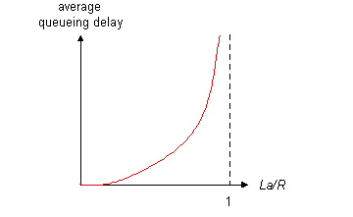
Queuing delay (revisited)
R=link bandwidth (bps)
L=packet length (bits)
a=average packet arrival rate
traffic intensity = La/R
La/R ~ 0: average queuing delay small
La/R -> 1: delays become large
La/R > 1: more “work” arriving than can be serviced, average delay infinite!

Slide 66
How do loss and delay occur?
packets queue in router buffers
packet arrival rate to link (temporarily) exceeds output link capacity
packets queue, wait for turn
packet being transmitted (delay)
A
B
packets queueing (delay)
free (available) buffers: arriving packets
dropped (loss) if no free buffers

Slide 67
Four sources of packet delay
transmission
A
propagation
B
nodal
processing
queueing
d_{nodal} = d_{proc} + d_{queue} + d_{trans} + d_{prop}
d_{proc}: nodal processing
check bit errors
determine output link
typically < msec
d_{queue}: queueing delay
time waiting at output link for transmission
depends on congestion level of router

Slide 68
Four sources of packet delay
transmission
A
propagation
B
nodal
processing
queueing
d_{nodal} = d_{proc} + d_{queue} + d_{trans} + d_{prop}
d_{trans}: transmission delay:
L: packet length (bits)
R: link bandwidth (bps)
d_{trans} = L/R
d_{prop}: propagation delay:
d: length of physical link
s: propagation speed (~2x10⁸ m/sec)
d_{prop} = d/s
d_{trans} and d_{prop}
very different
Notes:
68

Slide 69
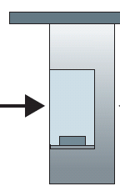
Caravan analogy
100 km
100 km
ten-car
caravan
toll
booth
toll
booth
cars “propagate” at
100 km/hr
toll booth takes 12 sec to service car (bit transmission time)
car ~ bit; caravan ~ packet
Q: How long until caravan is lined up before 2nd toll booth?
time to “push” entire caravan through toll booth onto highway = 12*10 = 120 sec
time for last car to propagate from 1st to 2nd toll both: 100km/(100km/hr)= 1 hr
A: 62 minutes

Slide 70
Caravan analogy (more)
100 km
100 km
ten-car
caravan
toll
booth
toll
booth
suppose cars now “propagate” at 1000 km/hr
and suppose toll booth now takes one min to service a car
Q: Will cars arrive to 2nd booth before all cars serviced at first booth?
A: Yes! after 7 min, first car arrives at second booth; three cars still at first booth

Slide 71

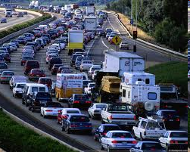
Queueing delay (revisited)
R: link bandwidth (bps)
L: packet length (bits)
a: average packet arrival rate
average queueing delay
traffic intensity
= La/R
La/R ~ 0: avg. queueing delay small
La/R -> 1: avg. queueing delay large
La/R > 1: more “work” arriving
than can be serviced, average delay infinite!
La/R ~ 0
La/R -> 1
* Check online interactive animation on queuing and loss

Slide 72
“Real” Internet delays and routes
what do “real” Internet delay & loss look like?
traceroute program: provides delay measurement from source to router along end-end Internet path towards destination. For all i:
  sends three packets that will reach router i on path towards destination
  router i will return packets to sender
  sender times interval between transmission and reply.
3 probes
3 probes
3 probes

Slide 73
“Real” Internet delays, routes
traceroute: gaia.cs.umass.edu to www.eurecom.fr
3 delay measurements from
gaia.cs.umass.edu to cs-gw.cs.umass.edu
1 cs-gw (128.119.240.254) 1 ms 1 ms 2 ms
2 border1-rt-fa5-1-0.gw.umass.edu (128.119.3.145) 1 ms 1 ms 2 ms
3 cht-vbns.gw.umass.edu (128.119.3.130) 6 ms 5 ms 5 ms
4 jn1-at1-0-0-19.wor.vbns.net (204.147.132.129) 16 ms 11 ms 13 ms
5 jn1-so7-0-0-0.wae.vbns.net (204.147.136.136) 21 ms 18 ms 18 ms
6 abilene-vbns.abilene.ucaid.edu (198.32.11.9) 22 ms 18 ms 22 ms
7 nycm-wash.abilene.ucaid.edu (198.32.8.46) 22 ms 22 ms 22 ms
8 62.40.103.253 (62.40.103.253) 104 ms 109 ms 106 ms
9 de2-1.de1.de.geant.net (62.40.96.129) 109 ms 102 ms 104 ms
10 de.fr1.fr.geant.net (62.40.96.50) 113 ms 121 ms 114 ms
11 renater-gw.fr1.fr.geant.net (62.40.103.54) 112 ms 114 ms 112 ms
12 nio-n2.cssi.renater.fr (193.51.206.13) 111 ms 114 ms 116 ms
13 nice.cssi.renater.fr (195.220.98.102) 123 ms 125 ms 124 ms
14 r3t2-nice.cssi.renater.fr (195.220.98.110) 126 ms 126 ms 124 ms
15 eurecom-valbonne.r3t2.ft.net (193.48.50.54) 135 ms 128 ms 133 ms
16 194.214.211.25 (194.214.211.25) 126 ms 128 ms 126 ms
17 * * *
18 * * *
19 fantasia.eurecom.fr (193.55.113.142) 132 ms 128 ms 136 ms
trans-oceanic
link
* means no response (probe lost, router not replying)
* Do some traceroutes from exotic countries at www.traceroute.org

Slide 74
Packet loss
queue (aka buffer) preceding link in buffer has finite capacity
packet arriving to full queue dropped (aka lost)
lost packet may be retransmitted by previous node, by source end system, or not at all
buffer
(waiting area)
A
packet being transmitted
B
packet arriving to
full buffer is lost
* Check out the Java applet for an interactive animation on queuing and loss

Slide 75
Throughput
throughput: rate (bits/time unit) at which bits transferred between sender/receiver
  instantaneous: rate at given point in time
  average: rate over longer period of time
server, with
file of F bits
to send to client
link capacity
R_{s} bits/sec
link capacity
R_{c} bits/sec
server sends bits
(fluid) into pipe
pipe that can carry
fluid at rate
R_{s} bits/sec)
pipe that can carry
fluid at rate
R_{c} bits/sec)

Slide 76
Throughput (more)
R_{s} < R_{c} What is average end-end throughput?
R_{s} bits/sec
R_{c} bits/sec
R_{s} > R_{c} What is average end-end throughput?
R_{s} bits/sec
R_{c} bits/sec
bottleneck link
link on end-end path that constrains end-end throughput

Slide 77
Throughput: Internet scenario
per-connection end-end throughput: min(R_{c},R_{s},R/10)
in practice: R_{c} or R_{s} is often bottleneck
R_{s}
R_{s}
R_{s}
R
R_{c}
R_{c}
R_{c}
10 connections (fairly) share backbone bottleneck link R bits/sec

Slide 78
Protocol “Layers”
Networks are complex!
many “pieces”:
  hosts
  routers
  links of various media
  applications
  protocols
  hardware, software
Question:
Is there any hope of organizing structure of a network?
Or at least our discussion of networks?

Slide 79
Organization of air travel
ticket (purchase)
baggage (check)
gates (load)
runway takeoff
airplane routing
ticket (complain)
baggage (claim)
gates (unload)
runway landing
airplane routing
airplane routing
a series of steps

Slide 80
Organization of air travel: a different view
ticket (purchase)
baggage (check)
gates (load)
runway takeoff
airplane routing
ticket (complain)
baggage (claim)
gates (unload)
runway landing
airplane routing
airplane routing
Layers: each layer implements a service
  via its own internal-layer actions
  relying on services provided by layer below

Slide 81
Layered air travel: services
Counter-to-counter delivery of person+bags
baggage-claim-to-baggage-claim delivery
people transfer: loading gate to arrival gate
runway-to-runway delivery of plane
airplane routing from source to destination

Slide 82
Distributed implementation of layer functionality
ticket (purchase)
baggage (check)
gates (load)
runway takeoff
airplane routing
ticket (complain)
baggage (claim)
gates (unload)
runway landing
airplane routing
Departing airport
Arriving airport
intermediate air traffic sites
airplane routing
airplane routing
airplane routing

Slide 83
Why layering?
Dealing with complex systems:
explicit structure allows identification, relationship of complex system’s pieces
  layered reference model for discussion
modularization eases maintenance, updating of system
  change of implementation of layer’s service transparent to rest of system
  e.g., change in gate procedure doesn’t affect rest of system
layering considered harmful?

Slide 84
Internet 7 layer protocol stack
application: supporting network applications
  ftp, smtp, http
  Two layers in here for this course Session and Presenation
transport: host-host data transfer
  tcp, udp
network: routing of datagrams from source to destination
  ip, routing protocols
link: data transfer between neighboring network elements
  ppp, ethernet
physical: bits “on the wire”
PDU – protocol data units
application
transport
network
link
physical
Session
Presentation

Slide 85
Layering: logical communication
Each layer:
distributed
“entities” implement layer functions at each node
entities perform actions, exchange messages with peers
application
transport
network
link
physical
network
link
physical
application
transport
network
link
physical
application
transport
network
link
physical
application
transport
network
link
physical

Slide 86
Layering: logical communication
data
E.g.: transport
take data from app
add addressing, reliability check info to form “datagram”
send datagram to peer
wait for peer to ack receipt
analogy: post office
application
transport
network
link
physical
transport
ack
network
link
physical
application
transport
network
link
physical
data
data
application
transport
network
link
physical
application
transport
network
link
physical
transport

Slide 87
Layering: physical communication
data
application
transport
network
link
physical
network
link
physical
application
transport
network
link
physical
data
application
transport
network
link
physical
application
transport
network
link
physical

Slide 88


What’s a protocol?
human protocols:
“what’s the time?”
“I have a question”
Registering for classes
… specific msgs sent
… specific actions taken when msgs received, or other events
Hi
Hi
Got the
time?
2:00
time

Slide 89
What’s a protocol?
a human protocol and a computer network protocol:
network protocols:
machines rather than humans
all communication activity in Internet governed by protocols
TCP connection
req.
TCP connection
reply.
protocols define format, order of msgs sent and received among network entities, and actions taken on msg transmission and/or receipt
Get http://www.gwu.edu/default.htm
<file>
time

Slide 90
Protocol layering and data
Each layer takes data from above
adds header information to create new data unit
passes new data unit to layer below
source
destination
M
application
transport
network
link
physical
application
transport
network
link
physical
M
message
H
M
H
t
M
segment
t
H
H
H
H
M
datagram
n
t
M
n
t
H
H
H
H
H
H
M
frame
l
n
t
M
l
n
t

Slide 91
Internet structure: network of networks
roughly hierarchical
national/international backbone providers (NBPs)
  e.g. BBN/GTE, Sprint, AT&T, IBM, UUNet
  interconnect (peer) with each other privately, or at public Network Access Point (NAPs)
regional ISPs
  connect into NBPs
local ISP, company
  connect into regional ISPs
local
ISP
regional ISP
NBP B
NAP
NAP
NBP A
regional ISP
local
ISP

Slide 92
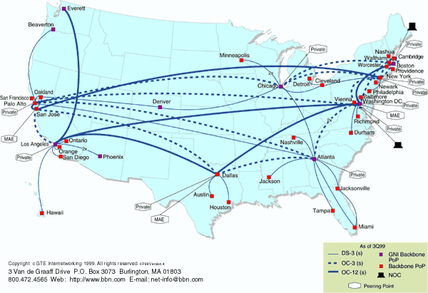
National Backbone Provider
e.g. BBN/GTE US backbone network 2004
Notes:
https://en.wikipedia.org/wiki/Internet_backbone
https://en.wikipedia.org/wiki/Tier_1_network
http://pages.cs.wisc.edu/~pb/publications.html

Slide 93
ATM: Asynchronous Transfer Mode nets
Internet:
today’s de facto standard for global data networking
1980’s:
telco’s develop ATM: competing network standard for carrying high-speed voice/data
standards bodies:
  ATM Forum
  ITU
ATM principles:
small (48 byte payload, 5 byte header) fixed length cells (like packets)
  fast switching
  small size good for voice
virtual-circuit network: switches maintain state for each “call”
well-defined interface between “network” and “user” (think of telephone company)

Slide 94
ATM layers
application
TCP/UDP
IP
ATM Adaptation Layer (AAL): interface to upper layers
  end-system
  segmentation/reassembly
ATM Layer: cell switching
Physical
AAL
ATM
physical
application
TCP/UDP
IP
ATM
physical
AAL
ATM
physical
application
TCP/UDP
IP
application
TCP/UDP
IP
Where’s the application?
ATM: lower layer
functionality only
IP-over ATM: later
AAL
ATM
physical
AAL
ATM
physical

Slide 95
Network security
field of network security:
  how bad guys can attack computer networks
  how we can defend networks against attacks
  how to design architectures that are immune to attacks
Internet not originally designed with (much) security in mind
  original vision: “a group of mutually trusting users attached to a transparent network” ☺
  Internet protocol designers playing “catch-up”
  security considerations in all layers!

Slide 96
Bad guys: put malware into hosts via Internet
malware can get in host from:
  virus: self-replicating infection by receiving/executing object (e.g., e-mail attachment)
  worm: self-replicating infection by passively receiving object that gets itself executed
spyware malware can record keystrokes, web sites visited, upload info to collection site
infected host can be enrolled in botnet, used for spam. DDoS attacks

Slide 97
Bad guys: attack server, network infrastructure
Denial of Service (DoS): attackers make resources (server, bandwidth) unavailable to legitimate traffic by overwhelming resource with bogus traffic
1. select target
2. break into hosts around the network (see botnet)
3. send packets to target from compromised hosts
target

Slide 98
Bad guys can sniff packets
packet “sniffing”:
  broadcast media (shared Ethernet, wireless)
  promiscuous network interface reads/records all packets (e.g., including passwords!) passing by
A
C
src:B dest:A payload
B
  wireshark software used for end-of-chapter labs is a (free) packet-sniffer

Slide 99
Bad guys can use fake addresses
IP spoofing: send packet with false source address
A
C
src:B dest:A payload
B
… lots more on security (throughout, Chapter 8)

Slide 100
Chapter 1: roadmap
  1.1 what is the Internet?
  1.2 network edge
    end systems, access networks, links
  1.3 network core
    packet switching, circuit switching, network structure
  1.4 delay, loss, throughput in networks
  1.5 protocol layers, service models
  1.6 networks under attack: security
  1.7 history
Notes:
100

Slide 101
Chapter 1: Summary
Covered a “ton” of material!
Internet overview
what’s a protocol?
network edge, core, access network
performance: loss, delay
layering and service models
backbones, NAPs, ISPs
ATM network
You now hopefully have:
context, overview, “feel” of networking
more depth, detail later in course

